Slide 1
Language models: tokens, attention and next-word probability
How does a language model turn your words into an answer, and why can the same question give different answers?
Applied AI and Automation | Session 5 of 14
KLAi Professional Learning | Jotham Martin Wambi
Notes:
Welcome to Session 5. Last time you saw words become numbers, and distance between them. Today you see what a language model does with those numbers to produce an answer. I use a real open model, GPT-2, running on this laptop, so every figure is a recorded result.
The question for today is this: How does a language model turn your words into an answer, and why can the same question give different answers? Keep it in mind. At the end of the session we come back to it and see how much more you can say.

Slide 2



Today in one view: what you will leave with
By the end of today you will have
See real tokens, real next-word probabilities and a real attention map from an open model
Work out a softmax and a tiny attention by hand with three numbers
Explain why the same question gives different answers and why a fluent answer can be wrong
Notes:
By the end you will have seen real tokens, real next-word probabilities and a real attention map. You will have computed a softmax and a small attention yourself, with three numbers. And you will be able to explain two things clients ask: why the same question gives different answers, and why a confident answer can be wrong.

Slide 3
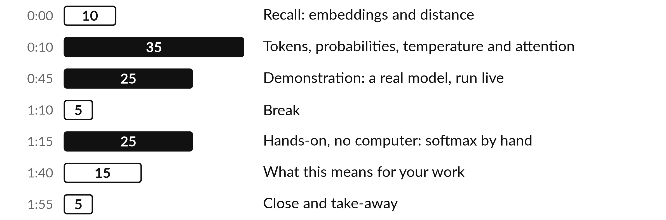
Your two hours: most of
the time is your own work
You watch a real open model work, then compute its core step with a pencil.
Notes:
We spend the first half hour on the ideas: tokens, the next-word guess, temperature and attention. Every picture uses numbers from a real open model that I ran on a laptop. Then I run the model live, so you see tokens and probabilities appear. After the break you work a softmax by hand on paper.
We end by deciding where this behaviour helps and where it hurts in your own work.

Slide 4

Three questions from last time
1. What is an embedding?
2. Name two ways to measure how close two embeddings are.
3. Why could the search find the formal contract term from a plain description?
Answer aloud first. Then we check together.
Notes:
Three quick questions from Session 4. Answer aloud first, and then we check together. It is a warm-up to bring last time back.
Question one. What is an embedding? Take a moment.
A good answer is this. A list of numbers that places a word or sentence as a point, so that similar meanings sit close together.
Question two. Name two ways to measure how close two embeddings are. Say it to yourself first.
A good answer is this. Straight-line (Euclidean) distance, city-block (Manhattan) distance, dot product, or cosine similarity, which compares the angle.
Question three. Why could the search find the formal contract term from a plain description? Think about your own task as you answer.
A good answer is this. Because the description and the clause sit close together as points, even when they share no words.
If an answer was missing, your own task card or last workbook page has it. Now to today.

Slide 5




Words we use today
Word | What it means
Token | A piece of text a model reads and writes: a short word, part of a long word, a number or a mark.
Softmax | A recipe that turns scores into percentages that add up to 100.
Temperature | A dial that sharpens or flattens the percentages before a piece is picked.
Attention | The step where each word looks back at earlier words and weighs which ones matter.
Context window | The most text, counted in tokens, that a model can look at in one go.
Notes:
Five words for today. I give the plain meaning of each, and we use every one of them before the end of the session.
Token. A piece of text a model reads and writes: a short word, part of a long word, a number or a mark.
Softmax. A recipe that turns scores into percentages that add up to 100.
Temperature. A dial that sharpens or flattens the percentages before a piece is picked.
Attention. The step where each word looks back at earlier words and weighs which ones matter.
Context window. The most text, counted in tokens, that a model can look at in one go.

Slide 6
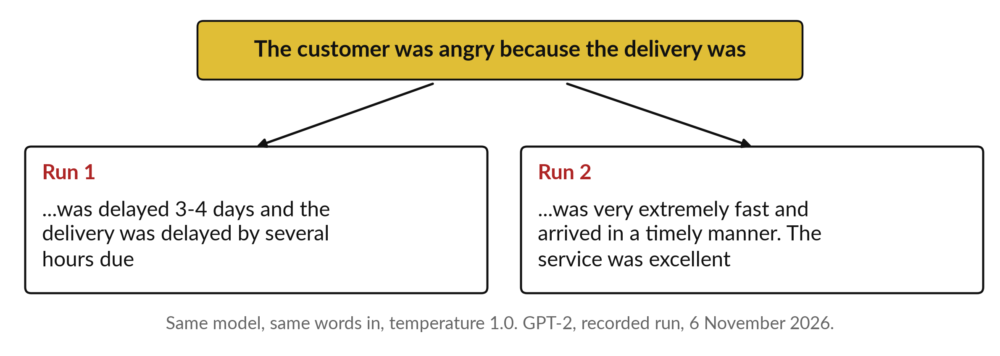
Ask the same model the same question
twice and the answers can differ
Two real runs of GPT-2, an open model, with the same words in.
Notes:
Let me start with something every executive has noticed. You ask an assistant the same question twice and get two different answers. Here I gave an open model, GPT-2, the same eight words twice. One run says the delivery was delayed. The other says it was fast and the service was excellent.
Nobody changed anything. Today I show you exactly why. It is not a fault. It is how the machine is built. By the end you can explain it to a colleague, and you can say what it means for checking answers.

Slide 7
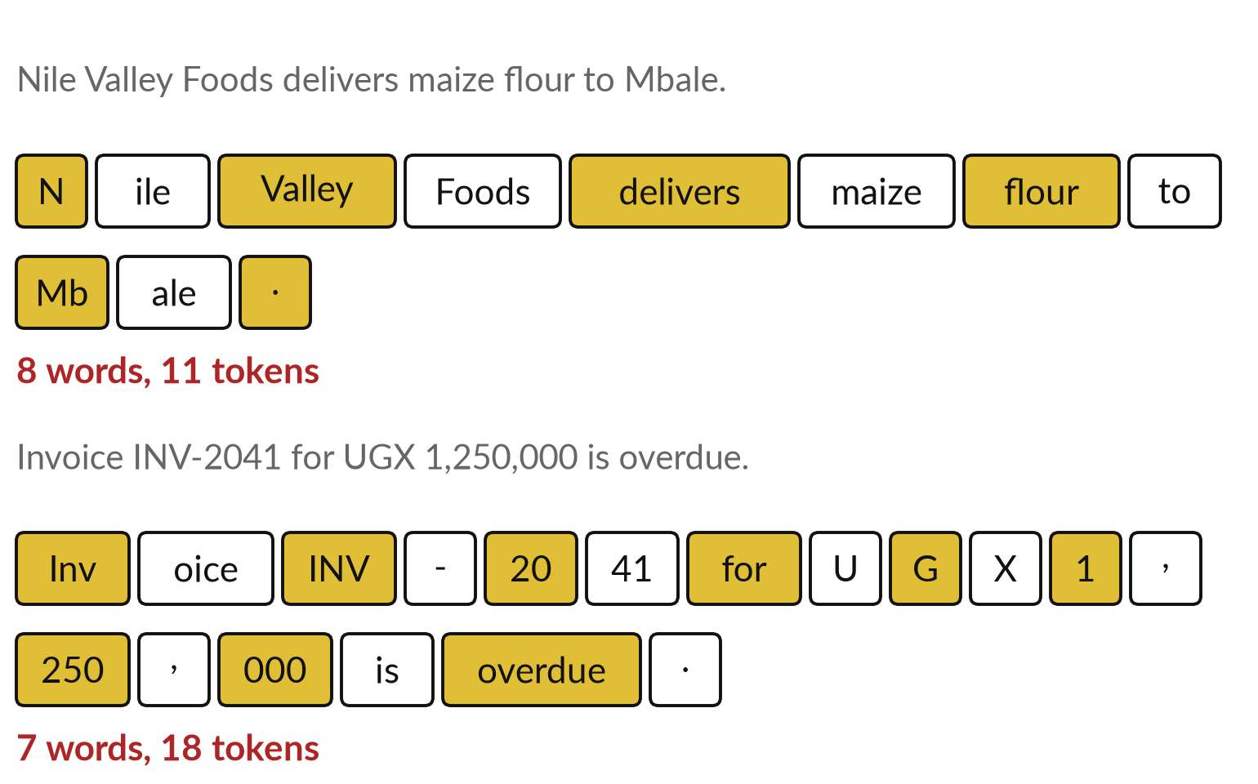
A model reads pieces called
tokens, like Lego bricks or syllables
A token is a piece of text. Gold and white bricks are separate tokens.
Common words are one brick.
Names, numbers and rare words snap together from several.
Notes:
A language model does not read letters or whole sentences. It reads tokens. Think of syllables in a word, or Lego bricks in a model. Common words such as flour or delivers are one brick. A name like Mbale becomes Mb and ale. An invoice number and an amount in shillings break into many small bricks.
These are real tokens from the GPT-2 tokenizer. The word for this cutting is tokenisation. The model never sees the words as you do. It sees a row of brick numbers.

Slide 8
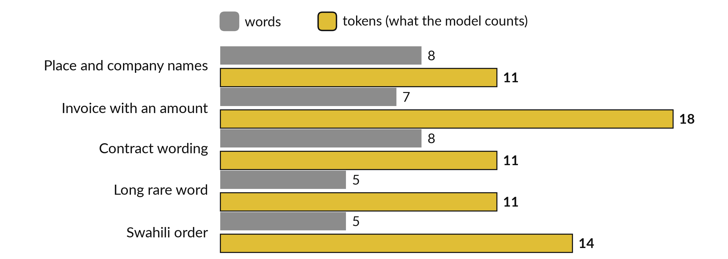
Amounts, names and Swahili need
more tokens than plain English
Real GPT-2 token counts. A second tool, tiktoken, gave the same pieces.
Notes:
Here are five NVF sentences, counted two ways. The grey bar is words. The gold bar is tokens. The invoice sentence has seven words but eighteen tokens, because the amount and the invoice number shatter into small pieces. The Swahili order has five words and fourteen tokens. This matters for your work in two ways.
Many providers set limits and prices in tokens, so the same page of figures or Swahili text can cost more than a page of plain English. And a model handles rare pieces less well, because it has seen them less.

Slide 9
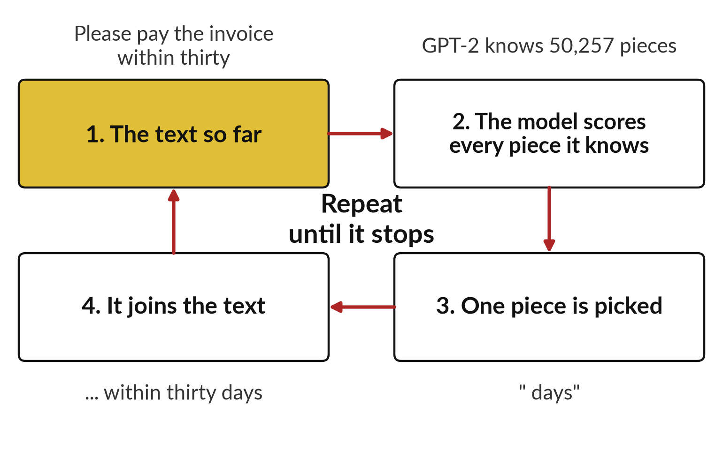
A language model does one thing: it
guesses the next piece, again and again
The whole answer is built one piece at a time.
Each new piece joins the text.
The longer text goes back in for the next guess.
Notes:
Here is the whole trick, in four boxes. The text so far goes into the model. The model gives a score to every piece it knows. For GPT-2 that is fifty thousand, two hundred and fifty-seven pieces. One piece is picked, for example days after the words pay within thirty.
That piece joins the text, and the longer text goes round again. A whole paragraph is just this loop repeated. The loop itself has no step that looks anything up. Keep that picture in mind for the rest of today.

Slide 10
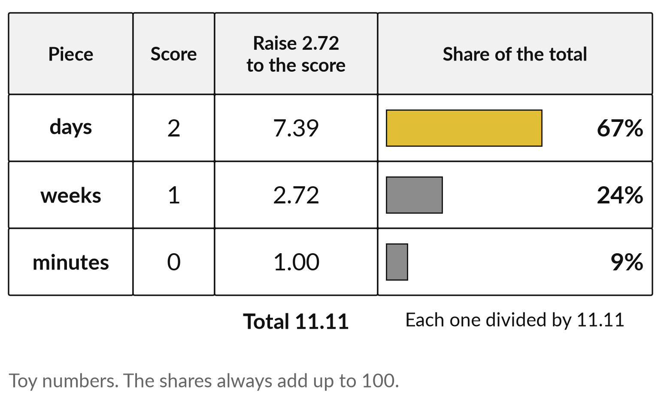
Softmax turns scores into
percentages with one recipe
Scores 2, 1 and 0 become 67, 24 and 9 percent.
Raise 2.72 to each score.
Divide each result by the total.
Notes:
The model gives each piece a score. Scores are awkward, so we turn them into percentages. The everyday picture is a committee vote where every member gets a share of the votes that depends on their score. The recipe has two steps. Raise two point seven two to the power of each score.
Then divide each answer by the total. With scores two, one and zero you get seven point three nine, two point seven two and one. The total is eleven point one one. Divide, and you get sixty-seven, twenty-four and nine percent. The real name is softmax. You do exactly this in the hands-on.

Slide 11
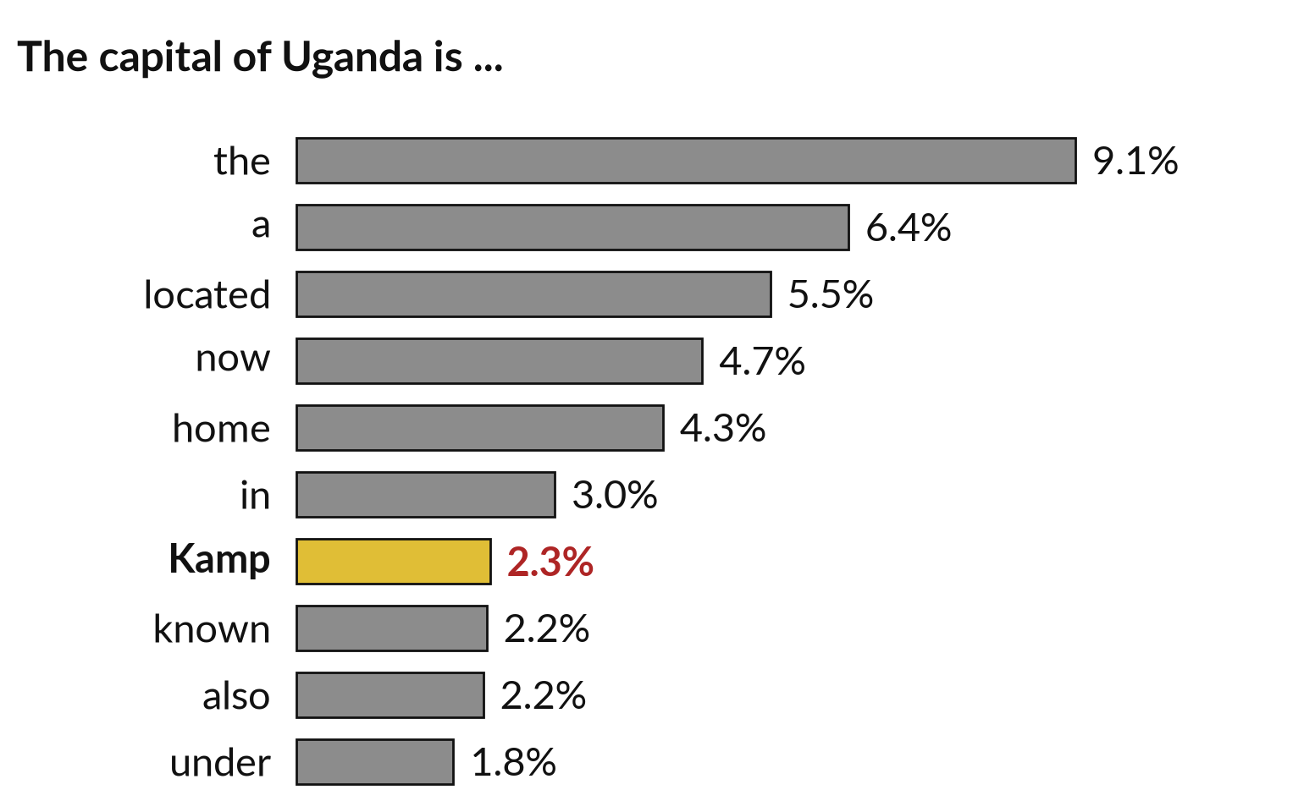
A real top ten: the favourite is not the truth
Kampala starts with the piece "Kamp", at 2.3 percent.
These are shares of likelihood in GPT-2, a small 2019 model.
They say nothing about what is true.
Notes:
This is the real list from GPT-2 for the sentence the capital of Uganda is. The model scores fifty thousand pieces, and these are the top ten. The word the is first, at nine percent. Kampala starts with the piece Kamp, highlighted, at two point three percent. GPT-2 is a small model from 2019, and larger modern models do much better on this question.
But the lesson holds for all of them. The list is shares of likelihood from patterns in text. It is not a lookup of facts.

Slide 12
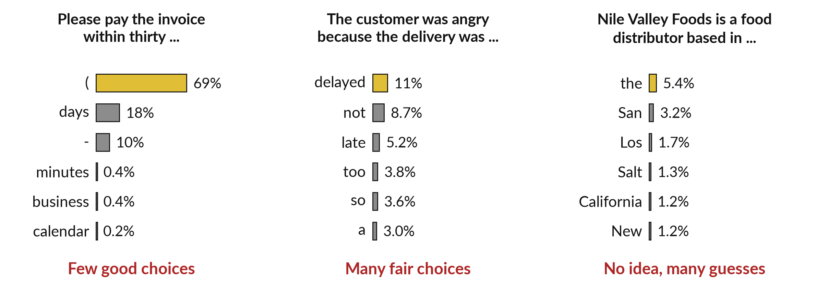
The shape of the list shows how sure the model is
Real GPT-2 lists. A tall bar is a safe guess. Many short bars spread the bets.
Notes:
Compare three real lists. After please pay the invoice within thirty, the model puts sixty-nine percent on an opening bracket and eighteen on days. Few good choices, so almost any run gives you a sensible continuation. After the customer was angry because the delivery was, the choices are many and close: delayed, not, late.
After Nile Valley Foods is a food distributor based in, the model has no idea and spreads its bets across American cities. The shape of the list is a measure of how sure the model is. In most chat tools you never see it.

Slide 13
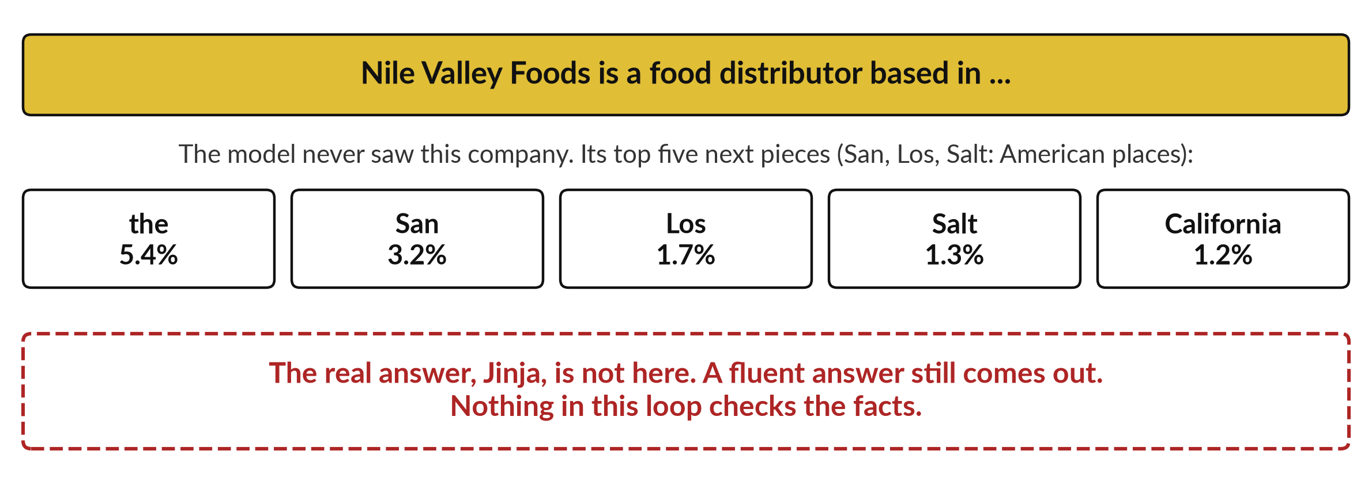
Sounding sure and being wrong
come from the same loop
A fluent sentence always comes out. Only search or files can add a check.
Notes:
Here is why a model can sound sure and be wrong. Whatever you give it, the loop produces the most plausible next piece. NVF is a made-up company, so the model has never read about it. Its top guesses for where it is based are mostly American place names, and the real answer, Jinja, is not among them.
It would still write a smooth sentence with one of them. Nothing in the loop asks is this true. Tools that add search or your own files reduce this, and I show how in Session 9. Until then, a confident tone says nothing about accuracy.

Slide 14
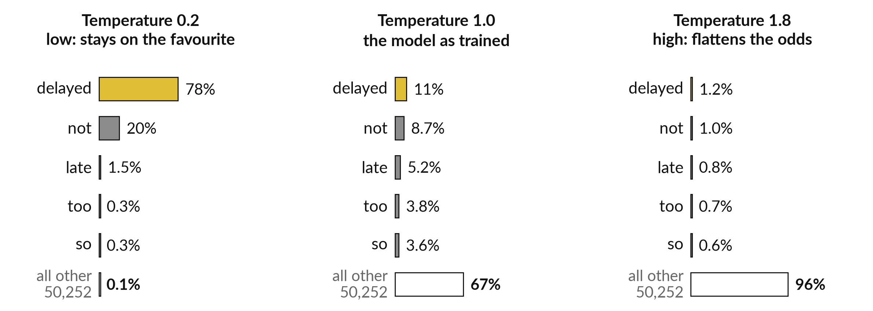
Temperature reshapes the
odds before a piece is picked
Real GPT-2 scores divided by the temperature, then softmax.
Notes:
Temperature is a dial. Before picking, the model divides every score by the temperature, then runs softmax. At zero point two, the favourite, delayed, takes seventy-eight percent and the rest nearly vanish. At one, the odds are as trained: delayed has eleven percent and sixty-seven percent sits outside the top five.
At one point eight the odds flatten, and ninety-six percent sits outside the top five, in a long tail of strange pieces. Low temperature gives repeatable and predictable answers. High temperature gives variety and eventually nonsense. Most tools choose a setting for you.

Slide 15
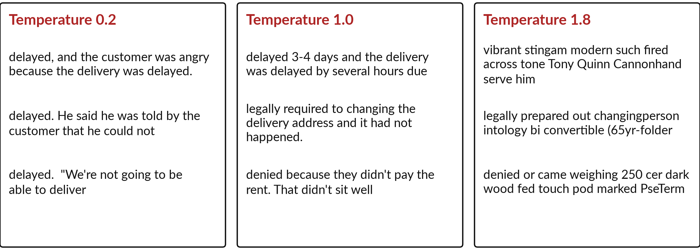
Low temperature repeats itself and
high temperature drifts into nonsense
Real sampled completions, three of six per setting. All six are in the recorded run.
Notes:
Now the effect on real text. I sampled completions from the same prompt at three settings. At zero point two, the three runs start the same way, with delayed, and one even repeats itself. At one, the runs go in different directions: a delay, a legal requirement, a rent dispute.
At one point eight the text is mostly noise. This is why the same question gives different answers: the final piece is drawn by chance from the percentages. Ask yourself which setting you want for a contract summary, and which for brainstorming product names.

Slide 16
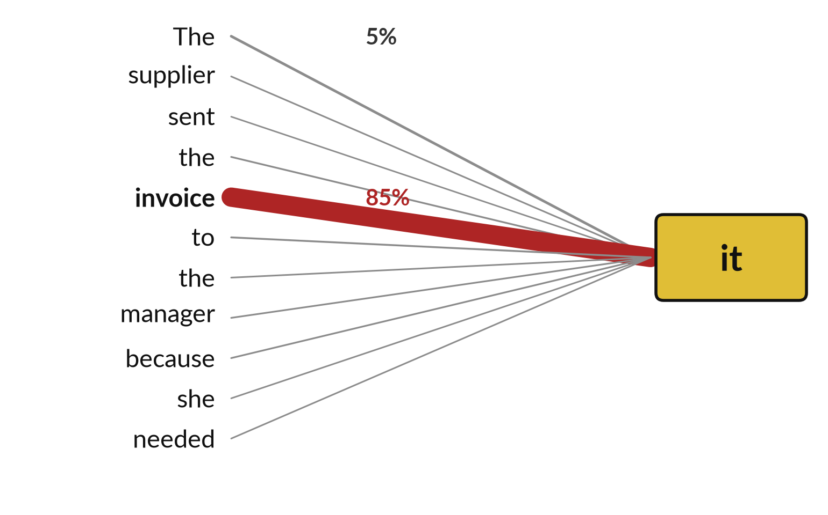
Attention asks: which earlier
words matter to this word?
To work out what "it" refers to, the model looks back and weighs each earlier word.
Thick line: a lot of attention.
The weights add up to 100 percent.
Notes:
Now the second idea, attention. Picture an accountant reading the sentence on the slide, which ends with the word it. At the word it, the accountant glances back to decide what it means. Attention is that glance. For each word, the model weighs which earlier words matter. The thickness of each line shows the weight.
In this real attention head from GPT-2, the word it puts eighty-five percent of its attention on invoice. This head looks like it tracks what refers to what, but that is my reading of one picture. Attention is a weighting, not understanding.

Slide 17
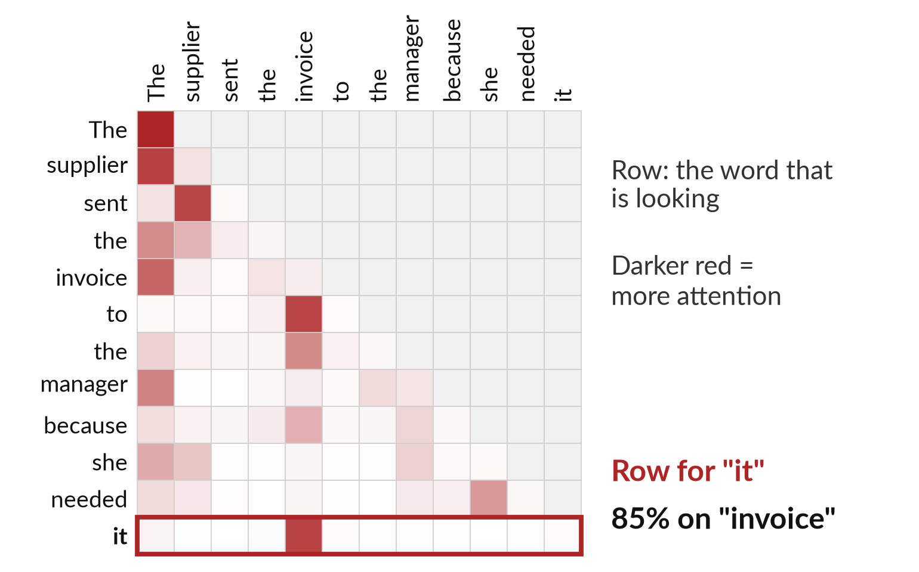
A real attention map: one
head of one layer of GPT-2
This is layer 5, head 4. GPT-2 small has 12 layers of 12 heads.
Each row is a word looking back.
A word cannot look ahead.
Notes:
This is the same attention as a grid. Each row is the word that is looking. Each column is an earlier word it may look at. Darker red means more attention. The empty upper triangle is there because a word cannot look at words that come later. The bottom row, circled, is the word it, and it puts eighty-five percent on invoice.
I must be clear: this is one head of one layer. GPT-2 small has twelve layers with twelve heads each, and larger models have many more. One head shows one pattern. It does not show what the model thinks.

Slide 18
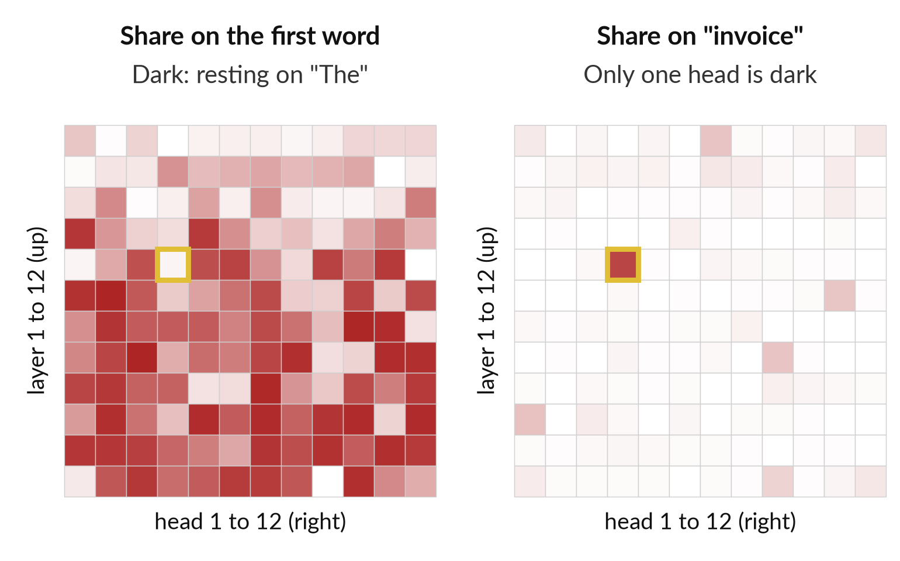
Most heads do something else,
and I searched for this one
Of 144 heads, 78 put over half their attention on the first word. Only one put over 30 percent on "invoice".
I searched all 144 to find a head that shows a clear pattern.
Notes:
Here I show the search itself. Each small square is one head, laid out by layer and head number. On the left, the darker the square, the more the word it rests on the first word of the sentence. Seventy-eight of the one hundred and forty-four heads do that.
It seems to be a resting place. On the right, only one head, ringed, puts much attention on invoice. I found it by searching. So a neat attention picture is a selected example. Treat anyone who says the model attends to the right thing with caution unless they show you the search.

Slide 19
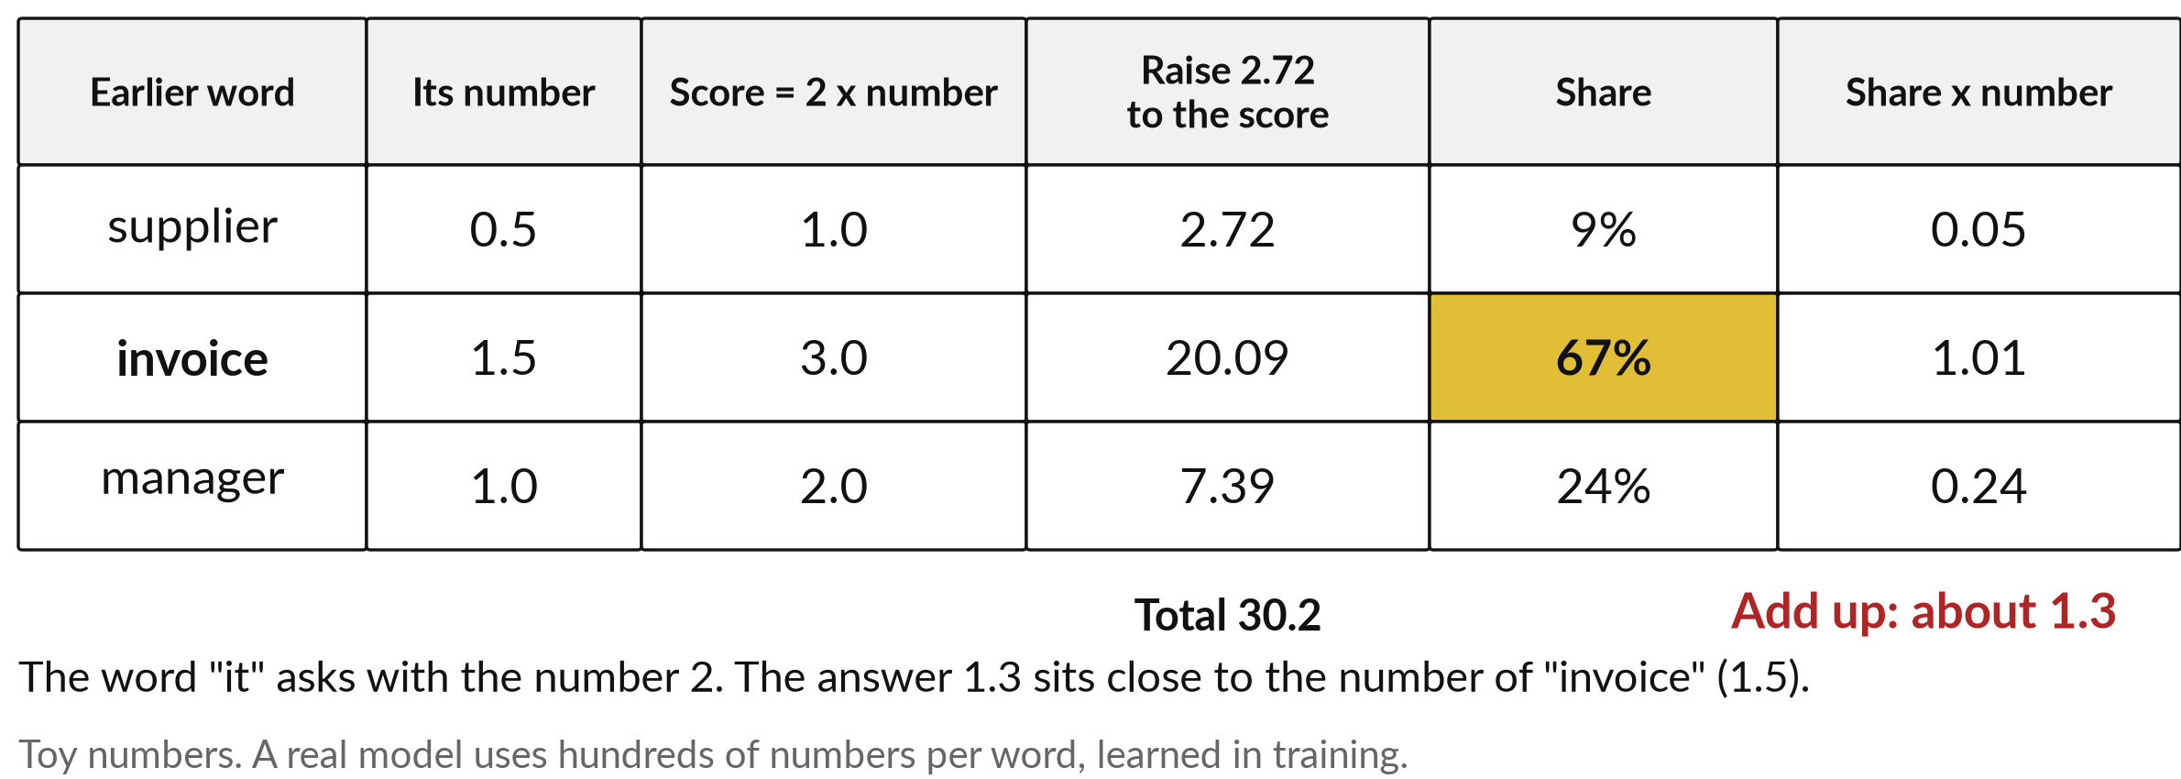
Attention by hand: three words, three numbers
The same softmax recipe blends three numbers. A real model learns hundreds per word.
Notes:
Let me do attention with a pencil. Three earlier words each carry one number: supplier zero point five, invoice one point five, manager one. The word it asks with the number two. Score each word by multiplying: one, three and two. Now the softmax recipe you just learned.
Raise two point seven two to each score: two point seven two, twenty point zero nine, seven point three nine. The total is thirty point two. The shares are nine, sixty-seven and twenty-four percent. Multiply each share by the word number and add up: about one point three.
The answer leans towards invoice. That is attention. Real models do this with hundreds of numbers per word.

Slide 20
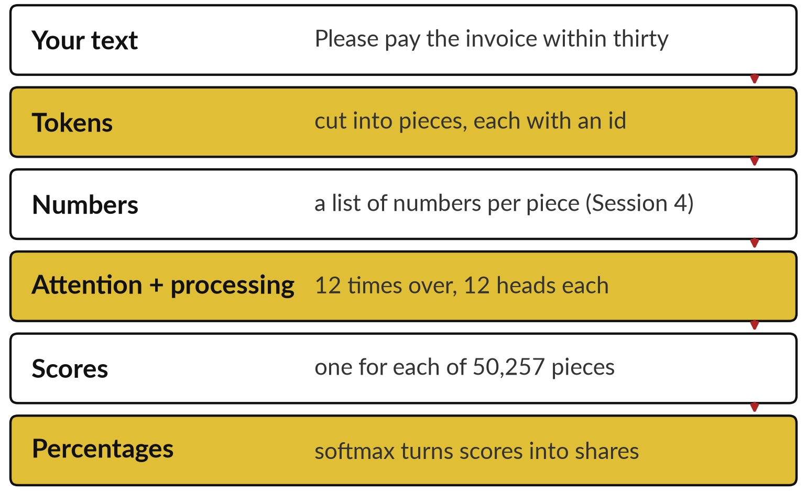
Put together: text to pieces to
numbers to attention to percentages
GPT-2 small repeats the attention step 12 times, then scores all 50,257 pieces.
It has 124 million adjustable numbers and reads at most 1,024 tokens at once.
Notes:
Here is the whole machine in one picture. Text is cut into tokens. Each token becomes a list of numbers, the same idea as the embeddings from Session 4. The numbers pass through twelve layers of attention and processing in GPT-2 small. Out come fifty thousand scores, and softmax makes percentages.
Then one piece is picked and the loop repeats. GPT-2 small has one hundred and twenty-four million adjustable numbers and can look at up to one thousand and twenty-four tokens at once. That limit is the context window. Modern assistants are larger in every way, but the loop is the same.

Slide 21
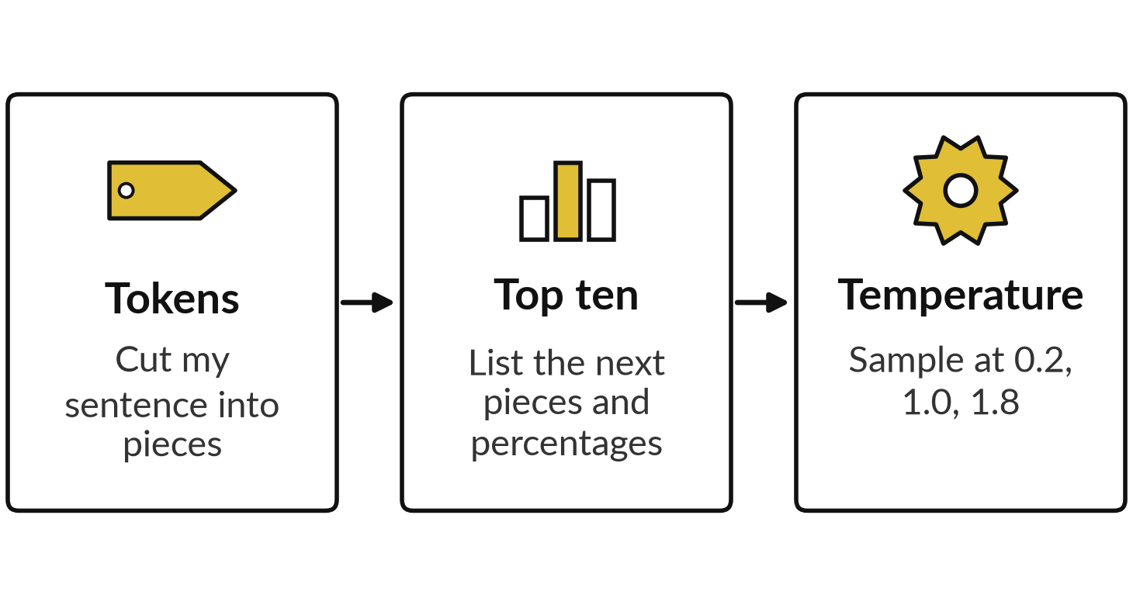
Demonstration: a real
model, run live on this laptop
I will show
Watch for
The token count compared with the word count.
The shape of each list: tall or flat.
Same prompt, different completions.
Your sentence from your own work.
Notes:
Now I run the model live. It is GPT-2 small, running on this laptop with no internet. First I type a sentence and show its tokens. Then I show the top ten next pieces with their percentages. Then I sample the same prompt at low, normal and high temperature.
Watch the shape of each list, tall or flat. Then give me a sentence from your own work, such as a clause or an invoice line, and we look at its tokens together. The recorded numbers on these slides are the fallback if the laptop misbehaves.

Slide 22
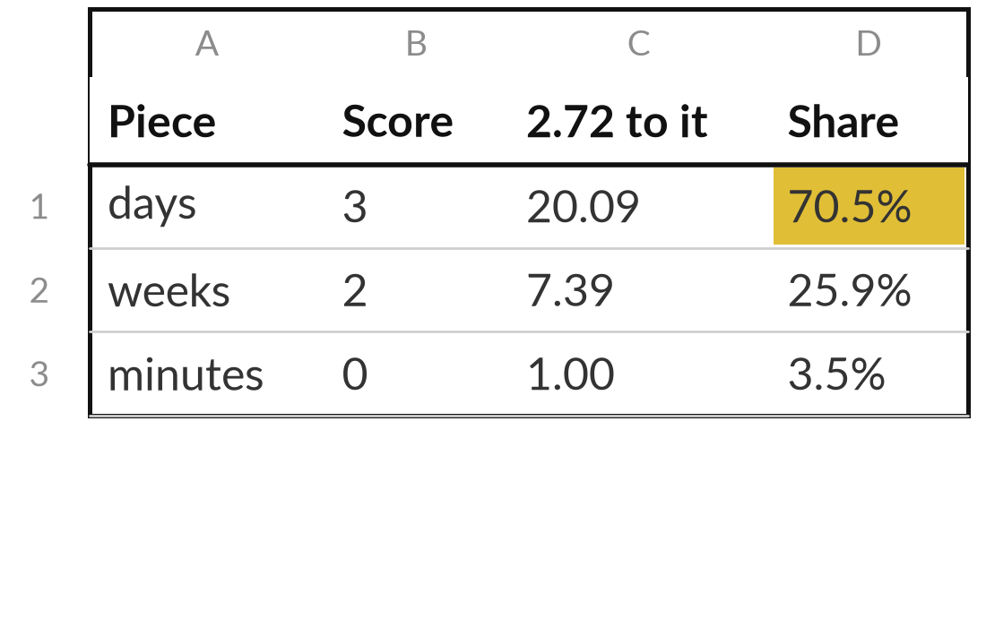
Work a softmax and a temperature by hand
25 minutes
Hands-on, no computer
Turn three scores into percentages, then see what a hotter dial does.
Raise 2.72 to each score: 3, 2 and 0.
Add the three answers. Divide each by the total.
Divide the scores by 2 first (the temperature). Repeat.
Say which setting gives the safer answer.
You keep: The worksheet with both sets of percentages and one sentence on what you see.
Notes:
Now your turn, with a pencil or a spreadsheet, no computer needed. The worksheet has three scores. Raise two point seven two to each score. A calculator helps. Add the three answers, then divide each answer by the total, so you get three percentages. Then divide the scores by two, which is a temperature of two, and repeat.
Compare the two sets. Which setting gives the safer answer, and which gives more variety?
The table shows the finished first half, so you can check your method. For the second half, expect about fifty-five, thirty-three and twelve percent. Call me over when you have both sets.

Slide 23
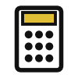





Next-word behaviour helps with
drafts and hurts with facts and figures
Job | Helps or hurts? | Why
Finance: reconcile amounts | Hurts | Numbers split into many tokens; check every figure
Customer service: draft a reply | Helps | Many good phrasings; you review
HR: summarise a CV | Mixed | Fluent, but it can add details; verify
Sales: product name ideas | Helps | Variety is the goal; raise the temperature
Legal: quote a clause | Hurts | It may produce a likely clause; check the source
Operations: fixed report layout | Helps | Low variety; repeatable
Notes:
Here is the lesson turned into a table across the company. Where a job needs variety, drafting a reply or naming a product, next-word behaviour helps and you review. Where a job needs exact figures or exact wording, reconciling amounts or quoting a clause, it hurts, because the model produces what is likely and you must check against the source.
Summarising a CV is mixed. The output is fluent, and the model may add a detail that was never there. Use this table to decide where you let the tool draft and where you demand a source.

Slide 24




Where would you let next-word
prediction help or hurt in your work?
Pick one real task from your job. Is the next-word guess the right engine for it?
Draft
Draft and check
Needs a source
Keep it human
Variety is welcome. A person edits the result.
Useful, but every fact or figure is checked against a source.
The answer must come from your documents. Wait for Session 9.
Exact wording or amounts matter too much for a likely guess.
Write the task, your choice and one reason in your workbook.
Notes:
Take one real task from your job. Is the next-word guess the right engine for it?
Draft means variety is welcome and a person edits. Draft and check means it is useful, but every fact and figure is checked against a source. Needs a source means the answer must come from your own documents, and in Session 9 you see how to do that.
Keep it human means exact wording or amounts matter too much for a likely guess. Tell me your task and your choice, and one reason. There is no right answer, only a reasoned one.

Slide 25
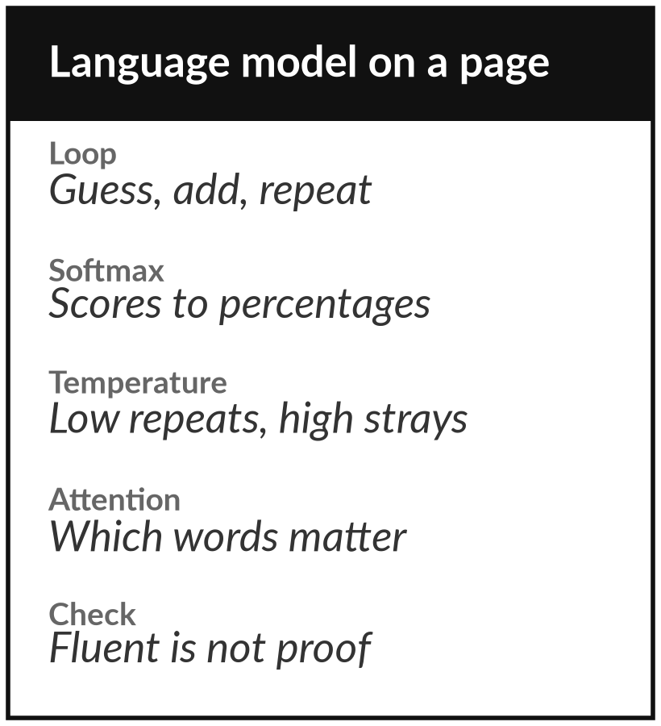
Keep the one-page sheet: how a
language model picks its next word
What you keep from today
A one-page sheet: the next-word loop, the softmax recipe, what temperature does and five questions to ask about any language-model answer.
Our question today
How does a language model turn your words into an answer, and why can the same question give different answers?
Next session
Session 6: Foundation models. How pretraining and post-training make an assistant, and how to read a model card and a benchmark.
Notes:
Your take-away is a one-page sheet with the next-word loop, the softmax recipe, what temperature does, and five questions to ask about any language-model answer. Keep it beside your keyboard. Next session we ask how a model like this becomes an assistant: pretraining, post-training and how to read a model card.
We began with this question: How does a language model turn your words into an answer, and why can the same question give different answers? Before you go, say in one sentence what you can now say about it.

